Slide 1
4th July 2024

Slide 2
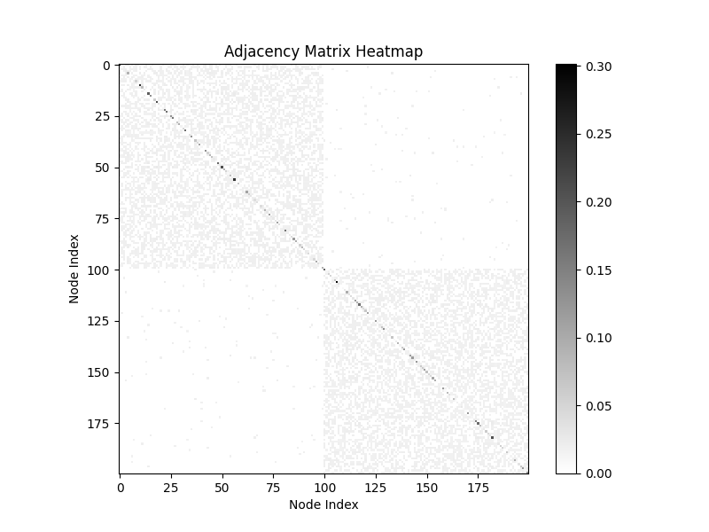
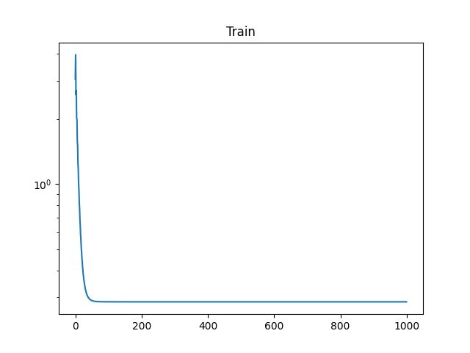

Consensus + Innovation Algorithm

Slide 3
Re-clustering Method Pseudocode
# Iterate the process until a predefined number of reclustering is met
FOR num_reclusters times DO
# Consensus Innovation Optimization
Calculate total MSE for the current adjacency matrix and data points
Update node weights using consensus innovation algorithm
# Re-cluster
Use the updated weights and predicted labels to re-cluster nodes
Update clustering labels
# Update adjacency matrix
Generate a new adjacency matrix based on the updated clustering labels

Slide 4
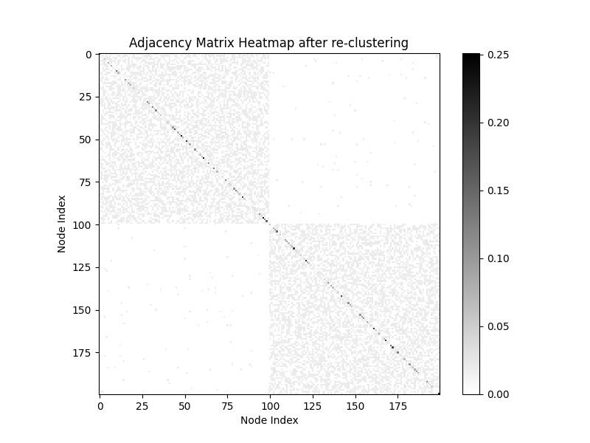
Adjacency Matrix Heatmap after 100 re-clustering

Slide 5
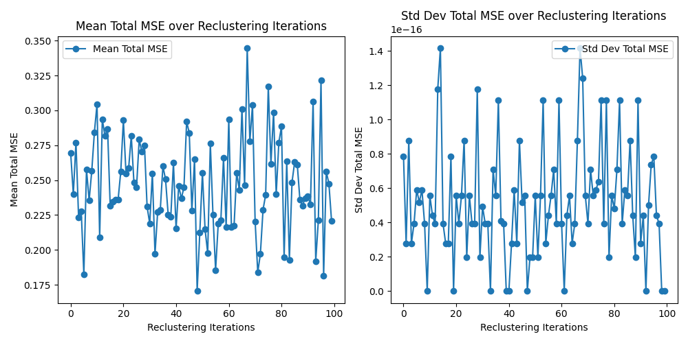
MSE over 100 Re-clustering Iterations
Best result
Mean MSE
0.1706470786135722
Std_dev MSE
1.962615573354719e-17

Slide 6

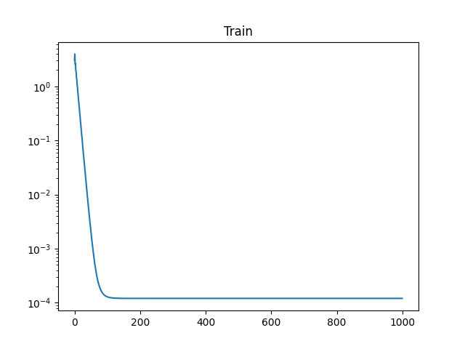

Adjust Adjacent Matrix

Slide 7
Compared Results
Method | Mean MSE | Std_dev MSE
Initial | 0.28643266691960595 | 8.777083671441753e-17
Re-clustering | 0.1706470786135722 | 1.962615573354719e-17
Adjust Adjacent Matrix | 0.00012064092626078424 | 4.747158350235376e-19

